Slide 1
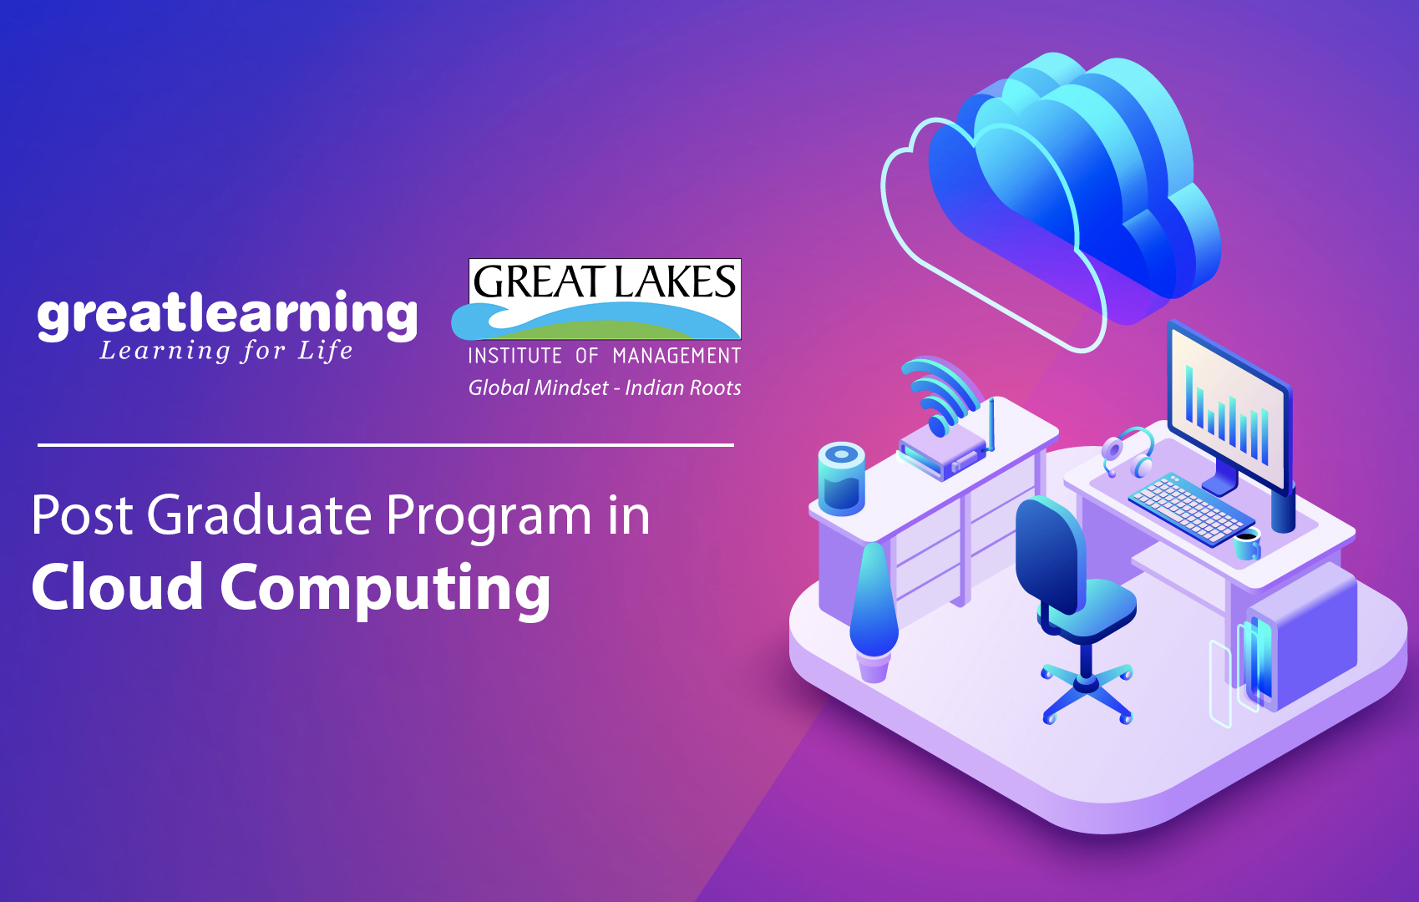
Corporate Philanthropy Platform - NEEDIFY

Slide 2

Use Case
Use Case | Latest events forum on CSR
Actor | End User
Use Case Overview | End User needs to know on latest events with social philanthropy needs
Subject Area | Philanthropy, social responsibility
Basic Flow | User Registers and Creates a WEB account with logical details, and system registers this. If user logs in it displays user with latest content , news, events in different categories of Philanthropy. If any new updates are received on platform user gets notified via email for changes

Slide 3
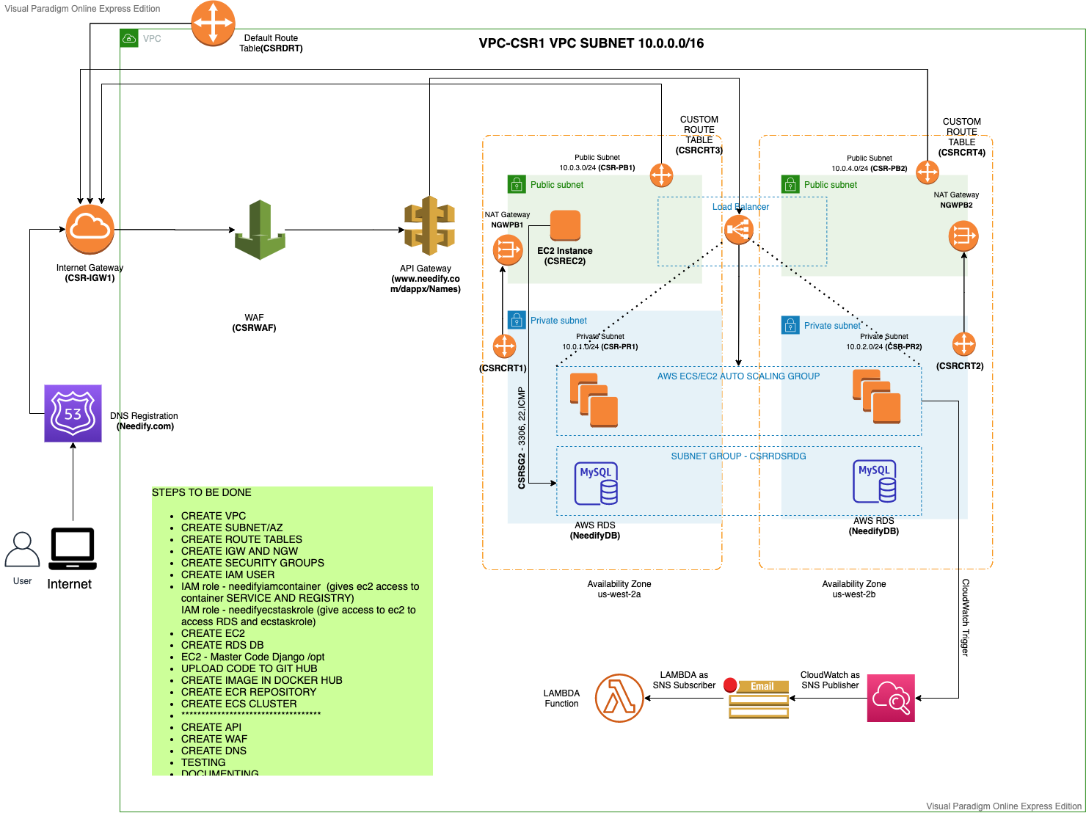
Architecture

Slide 4
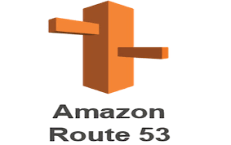
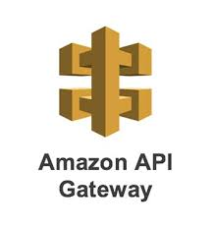
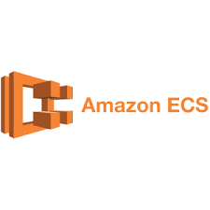
Role of Cloud
Services Used | Rationale Using Service
 | Requests to our server, Route 53 also provides free certificates and good integration A DNS mapping with Load Balancer and unique website selection
 | Provided ability to handle millions of employees with Auth-N/Auth-Z provided by corporate Identity Providers and Rate Limiting and fetching details using GET to LAMBDA for collecting details as RDS is in private subnet
 | Highly scalable, managed micro service platform to host various services in clusters Complete image is built as a container image and multiple containers can be populated for fault tolerance as a completely managed service

Slide 5
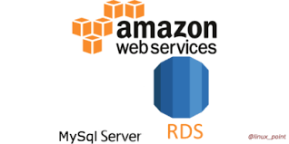
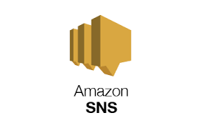
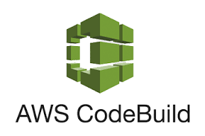
Role of Cloud
Services Used | Rationale Using Service
 | Used to store the registration details of the NGO and Corporates and individuals and this will be in millions and with a well defined schema and capabilities of SQL engine on cloud
 | Ability to broadcast e-mails for employees , set alert rule via cloud watch as publisher TOPIC and subscribe to updates from specific causes they feel passionate about(Emails fetch from API)
 | Fully managed code build capabilities to automate CICD flow

Slide 6
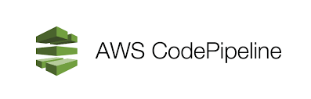
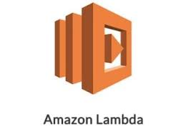

Role of Cloud
Services Used | Rationale Using Service
 | Fully managed pipeline with manual approval to Intervention to push the change and automate CICD flow
 | To fetch email address from databases and broadcast the SNS notifications. This will be invoked when changes to source code is done (new image PUSH)
 | A load balancer serves as the single point of contact for clients. The load balancer distributes incoming application traffic across multiple targets, such as EC2 instances, in multiple Availability Zones. This increases the availability of your application.

Slide 7



Role of Cloud
Services Used | Rationale Using Service
 | Launch AWS resources in a logically isolated virtual network that we have defined. Also to have ACLs and restrictions in virtual networking environment
 | To set rules and events and act as publisher to SNS for notifications to subscribers and capture all resources logs
 | Python web framework that enables rapid development of secure and maintainable websites. To leverage inbuilt capabilities like SERIALIZERS, DB Settings and RESTFRAMEWORKS

Slide 8
Project Demo
End to End demo of the project including : VIDEO TO BE ATTACHED AND RECORDED
Technical Demo – explaining the implemented architecture
Functional Demo – explaining the end user view / functionality

Slide 9
Team Role & Lessons learnt
Team Member Name | Contribution
Sri | Coding and designing of user-friendly portal (HTML) as per requirement Setting up AWS console for group and provisioning AWS console for team Setting up GitHub / Docker hub / accounts Container testing docker.io install in EC2
Samdeep | Code Layout and Software Architecture Use case deployment and API Gateway configurations CICD deployment ECS backend microservices deployment
Mayur | Architecting the solution design Database schema and Lambda function VPC and subnet architecture setup with DB in Multi AZ deployment and RDS subnet group creation Django framework bundling with compiling HTMLs for Needify platform
Prashant | Project Planning, Effort and cost analysis WAF, CloudFront and DNS, CloudWatch and Lambda for query ECR and docker hub initial deployment SNS, Cloud-watch integration for new event alerts rule

Slide 10
Team Role & Lessons learnt
Learning | Remarks
Development / Coding | Have got a thorough understanding of working of Django framework in Python and how other modules work in Django like RESTFRAMEWORK/ SERIALIZERS etc. with HTML page handling
Benefits over On-Prem | Pay as you go model and instantly provisioning of services and applications
Solutioning | Overall solutioning of the architecture and what fits best on case by case and need basis scenario and how to capture minute details like IAM role NAT gateways in scope for restrictions
Availability | Make application highly available using multi zone deployment model and blue/ green deployment model
Devops | CICD workflow for continuous integration with source code and how we can utilize AWS resources efficiently
Team-building | Working in a team with different background and domain and still working as a team to deliver the output
Project Planning | Planning sprints and agile approach for development and completing the project
Budgeting/Costing | Keep costs minimal and which services to opt to keep budget as minimum as possible
Concepts | Use the different AWS functionalities and services in our capstone, based on the performance & also, we were able to differentiate between uses of different AWS services in depth to finalize which services to use for our project benefit
Confidence | We were able to execute entire project from SOW to project closure using cloud services, starting from Concept, Design, Architecture, implementation and Review and deployment. This has tremendously built our confidence and new experience which helped us to understand better by making the hands dirty

Slide 11
Thank You !

